Slide 1
ICT407: IT Governance in Organisations
Week 9:
Lecturer: Dr. Farshid Keivanian

Slide 2
Information Privacy
Introduction: Information privacy is the control over what individuals or organizations allow others to know about them. It's subjective, unlike information security, which is more objective. The GDPR introduced a significant overhaul of privacy regulations in 2018, highlighting the importance of data protection.

Slide 3
Information Privacy
Practical Scenario: You work at Commonwealth Bank in Sydney, which handles sensitive customer data. Your team is developing a mobile app, and you must ensure that user privacy is protected. The app requires access to user passwords, location, and financial information.
Open-Ended Question: How would you ensure that the Commonwealth Bank app protects user privacy?

Slide 4
Information Privacy
Response: You could incorporate encryption, request user permission before accessing sensitive data, and implement privacy policies.
Multiple-Choice Question: Which legislation introduced the most significant changes to privacy regulations in 2018?
GDPR
HIPAA
CCPA
Australian Privacy Act

Slide 5
Information Privacy
Multiple-Choice Question: Which of the following is a key feature of the GDPR?
Unlimited data storage
Unrestricted data sharing
Data minimization
Lack of transparency

Slide 6
Privacy Policies
Introduction: Privacy policies outline how organizations manage personal information and ensure compliance with legal regulations. In Australia, the Privacy Act 1988 governs these responsibilities, which became even more critical with GDPR and CCPA's enactment.

Slide 7
Privacy Policies
Practical Scenario: You are the Chief Privacy Officer at Telstra in Melbourne. You’re tasked with drafting a privacy policy for a new service that collects customer data like phone numbers and addresses.
Open-Ended Question: What elements would you include in Telstra’s privacy policy to ensure compliance with data protection laws?

Slide 8
Privacy Policies
Response: Key elements include explaining the scope of the policy, data protection risks, data use, and how users can control or edit their information.
Follow-Up Question: How would you communicate any changes in the privacy policy to Telstra’s customers?

Slide 9
Data Breach and Cyber Attacks
Introduction: Data breaches pose a serious financial and reputational risk to organizations. In 2018, the average cost of a data breach was $4 million. Cyber-attacks can often go undetected for months, sometimes years, leaving organizations vulnerable.

Slide 10
Data Breach and Cyber Attacks
Practical Scenario: Woolworths in Brisbane recently suffered a data breach, exposing customer credit card information. You are tasked with responding to this breach.
Open-Ended Question: What immediate steps would you take to address the data breach at Woolworths and secure customer information?

Slide 11
Data Breach and Cyber Attacks
Response: You should secure the affected systems, notify customers immediately, and conduct an investigation with law enforcement.
Multiple-Choice Question: Which of the following is an effective first step in responding to a data breach?
Notify customers immediately
Ignore the breach
Open all files on the breached server
Post about the breach on social media

Slide 12
Insider Threat
Introduction: Insider threats, both malicious and accidental, can lead to significant data breaches. Employees who have access to sensitive data can misuse or accidentally leak it, with nearly 70% admitting to taking corporate property upon leaving an organization.

Slide 13
Insider Threat
Practical Scenario: An employee at Australia Post in Canberra leaked sensitive customer information by accidentally emailing it to the wrong person. You need to prevent similar incidents in the future.
Open-Ended Question: What preventive measures can Australia Post take to prevent insider threats, both malicious and accidental?

Slide 14
Insider Threat
Response: You could implement strict access controls, conduct regular security training, and utilize data loss prevention technologies.

Slide 15
Security Awareness Training (SAT)
Introduction: SAT programs train employees on how to recognize and respond to potential security threats. In 2020, companies in Australia reported a rise in phishing attacks, making SAT programs essential.

Slide 16
Security Awareness Training (SAT)
Practical Scenario: You work for Atlassian in Sydney, and you’ve noticed an increase in phishing attacks targeting employees. You’re tasked with developing a SAT program to address these threats.
Open-Ended Question: What topics would you include in Atlassian’s SAT program to help employees recognize phishing attacks?

Slide 17
Security Awareness Training (SAT)
Response: Topics could include phishing simulations, social engineering tactics, and instructions on handling suspicious emails.
Multiple-Choice Question: What is a key element of Security Awareness Training Program?
A one-time workshop
Encouraging employees to share passwords
Continuous, ongoing training
Keeping security measures secret

Slide 18
Data Governance
Introduction: Data governance ensures that information within an organization is managed securely, with proper access controls. Identity and Access Management (IAM) software plays a critical role in automating access permissions and preventing unauthorized access.

Slide 19
Data Governance
Practical Scenario: You work at Rio Tinto in Perth, which is introducing IAM software to manage access to sensitive mining data. You’re responsible for overseeing its implementation.
Open-Ended Question: How would you ensure that the IAM system is effectively governing access to data without hindering productivity at Rio Tinto?
Response: Implement role-based access controls, audit current access permissions, and ensure employees are trained on how to use the new system.

Slide 20
Data Loss Prevention (DLP)
Introduction: DLP technologies prevent sensitive data from leaving an organization’s network, especially through unauthorized channels like personal email accounts or USB drives.

Slide 21
Data Loss Prevention (DLP)
Practical Scenario: Qantas in Sydney is concerned that employees are using personal email accounts to send confidential documents. You’re tasked with implementing a DLP solution.
Open-Ended Question: How would you balance the need for Qantas employees to access and share information while ensuring data security through a DLP system?

Slide 22
Data Loss Prevention (DLP)
Response: Implement a DLP system that monitors outgoing emails, prevents unauthorized access, and educates employees on data security practices.

Slide 23
Group Class Activity – Presentation - Calibri Font 28 – F.Keivanian@aapoly.edu.au
Objective: By the end of this group activity, you will understand the potential cybersecurity issues and recommended solutions in line with Australian standards. Using real-world case scenarios, you will apply this knowledge to improve the security posture of an organization like Teradata Global Consulting Centre (GCC).

Slide 24
Group Class Activity – Presentation - Calibri Font 28 – F.Keivanian@aapoly.edu.au
Activity Overview:
In groups, you will be assigned a cybersecurity issue and tasked with providing both a problem analysis and solution recommendations based on the Teradata Global Consulting Centre (GCC) case and Australian standards. After discussing in your groups, each group will present their findings to the class.

Slide 25
Group Class Activity – Presentation - Calibri Font 28 – F.Keivanian@aapoly.edu.au
Step 1: Group Assignment (Choose issues)
A. Data Breach Scenario: Teradata GCC suffered a data breach, exposing client information.
Task: Identify the immediate actions Teradata should take to address the breach.
Discussion Question: How would you apply the Australian standards for data breaches to mitigate the impact of this breach?

Slide 26
Group Class Activity – Presentation - Calibri Font 28 – F.Keivanian@aapoly.edu.au
B. Insider Threats Scenario: An employee at Teradata GCC accidentally sent sensitive client information to a third party.
Task: Propose preventive measures to protect Teradata from insider threats.
Discussion Question: What strategies would you implement to reduce both accidental and malicious insider threats?

Slide 27
Group Class Activity – Presentation - Calibri Font 28 – F.Keivanian@aapoly.edu.au
C. Phishing and Business Email Compromise Scenario: Teradata is facing an increased number of phishing attacks targeting employee emails.
Task: Develop an anti-phishing strategy to protect Teradata from these threats.
Discussion Question: What security measures should Teradata implement to prevent phishing attacks and business email compromise?

Slide 28
Group Class Activity – Presentation - Calibri Font 28 – F.Keivanian@aapoly.edu.au
D. Ransomware and Malware Scenario: Teradata’s systems are at risk of a ransomware attack due to incomplete software updates.
Task: Recommend a defense strategy to protect Teradata’s systems from ransomware and malware attacks.
Discussion Question: How can Teradata use Australian cybersecurity guidelines to secure its systems from ransomware threats?

Slide 29
Group Class Activity – Presentation - Calibri Font 28 – F.Keivanian@aapoly.edu.au
Step 2: Group Presentation
Each group will present:
The identified cybersecurity threat at Teradata GCC based on Australian standards.
The potential impact of the threat on the organization (e.g., loss of reputation, financial damage).
Recommended solutions that align with Australian cybersecurity guidelines.
A follow-up question for the class to engage in further discussion

Slide 30
Group Class Activity – Presentation - Calibri Font 28 – F.Keivanian@aapoly.edu.au
Example Presentation Outline:
Group Name: Group A
Topic: Data Breach
Problem Identified: Teradata experienced a data breach exposing sensitive client information.
Australian Standard Guidelines: Follow the Notifiable Data Breaches (NDB) scheme.
Solution: Immediate notification to affected clients, full investigation, implement stronger encryption, and reinforce access controls.
Follow-Up Question: How can Teradata ensure that future breaches are prevented while maintaining operational efficiency?

Slide 31
Group Class Activity – Presentation - Calibri Font 28 – F.Keivanian@aapoly.edu.au
Assessment Criteria:
Problem Analysis: Did the group clearly identify the cybersecurity threat and its impact?
Solutions Provided: Were the solutions aligned with Australian standards and practical?
Engagement: Did the group engage the class in a meaningful follow-up discussion?
Presentation Clarity: Was the presentation clear, well-organized, and informative?

Slide 32
Group Class Activity – Presentation - Calibri Font 28 – F.Keivanian@aapoly.edu.au
Final Notes:
Interactive Approach: Ensure that each presentation involves active class participation, especially through follow-up questions. Use case examples relevant to Australian companies, such as Commonwealth Bank, Woolworths, Telstra, or Qantas.
Application of Australian Standards: Emphasize the importance of applying cybersecurity standards like the Australian Privacy Act, Notifiable Data Breach (NDB) scheme, and guidelines from cyber.gov.au.

Slide 33
Group Class Activity – Presentation - Calibri Font 28 – F.Keivanian@aapoly.edu.au
This group class activity will help you apply theoretical knowledge in real-world contexts, developing both your critical thinking and practical problem-solving skills in the realm of cybersecurity.

Slide 34
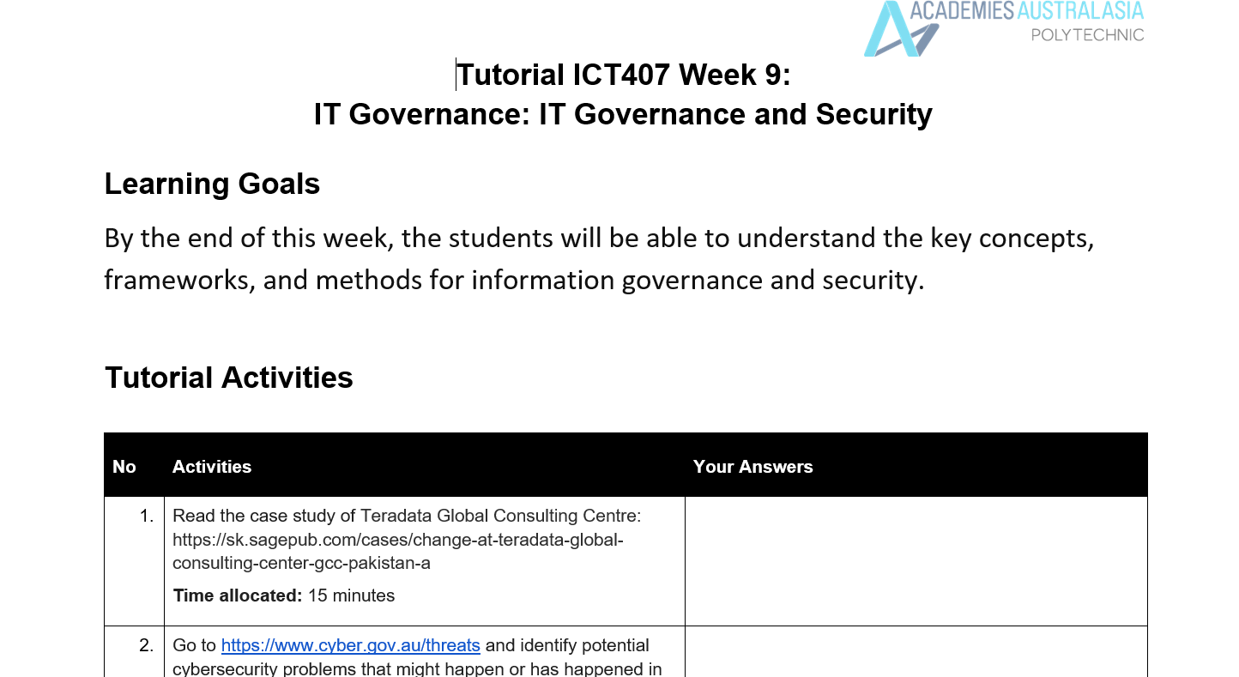
Tutorial Week 9

Slide 35
Tutorial Week 9
A table summarizing potential cybersecurity issues at Teradata Global Consulting Center based on Australian Standards and the threats outlined on the cyber.gov.au website:

Slide 36
Tutorial Week 9
Cybersecurity Threat | Cybersecurity Threat | Cybersecurity Threat
Data Breach | Teradata’s clientele was concerned about the security of proprietary data. A data breach could result from gaps in their ISO 27001 implementation, especially given the initial lack of full compliance across departments. | Data breaches, Hacking
Malicious Insiders | Employees or contractors may intentionally or unintentionally leak or misuse sensitive client data. Given the resistance from Line Managers to comply with ISO standards, there is a risk of non-compliance or sabotage. | Malicious insiders

Slide 37
Cybersecurity Threat | Cybersecurity Threat | Cybersecurity Threat
Phishing & Business Email Compromise | Teradata’s reliance on email communication for audits and certifications could make the company vulnerable to phishing attacks aimed at stealing sensitive data or compromising accounts. This could lead to business email compromise and loss of client trust. | Phishing, Business email compromise
Identity Theft | With international clients relying on Teradata GCC, identity theft could occur if unauthorized access to sensitive client data happens, especially during improper implementation of data access controls. | Identity theft

Slide 38
Cybersecurity Threat | Cybersecurity Threat | Cybersecurity Threat
Ransomware | The risk of ransomware attacks looms if security gaps persist in the data governance framework. This could lead to the encryption of vital client data, crippling operations and damaging the company's reputation. | Ransomware
Hacking & Unauthorized Access | Incomplete implementation of security protocols and internal resistance to ISO standards could leave the system vulnerable to hacking attempts, risking exposure of sensitive client information. | Hacking, Malware

Slide 39
Tutorial Week 9
Cybersecurity Threat | Cybersecurity Threat | Cybersecurity Threat
Account Compromise | Unauthorized access to company accounts could result from poor password management or weak employee awareness of security practices, especially with employees emailing sensitive documents to personal accounts. | Account compromise
Malware | Without consistent implementation of security software and policies, Teradata’s systems may be exposed to malware, potentially leading to data corruption or theft. | Malware
These threats highlight the need for Teradata GCC to strictly enforce ISO 27001 standards, enhance employee training on cybersecurity risks, and ensure robust data protection measures are in place.

Slide 40
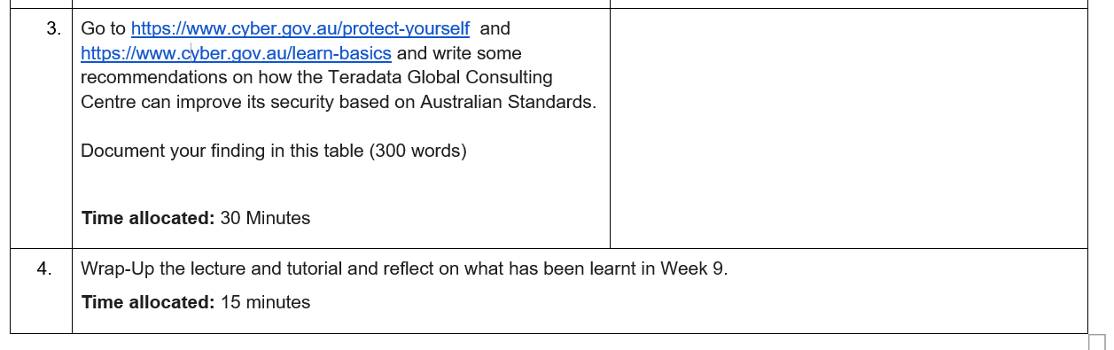
Tutorial Week 9

Slide 41
Tutorial Week 9
Here’s a table documenting recommendations on how Teradata Global Consulting Centre (GCC) can improve its security based on Australian standards:
Area | Recommendations | Details
Securing Accounts | Implement Multi-Factor Authentication (MFA) | To protect sensitive data, GCC should implement MFA for all employee accounts, ensuring that unauthorized access is minimized even if passwords are compromised. MFA adds an additional layer of security, making it harder for cybercriminals to gain access to accounts using stolen credentials. This aligns with the Australian standard for securing accounts.

Slide 42
Area | Recommendations | Details
Passphrases and Passwords | Use Secure Passphrases and Regular Updates | Encourage employees to use strong, unique passphrases for each account. Implement policies for regular password updates and ensure that employees are not reusing passwords. GCC should also educate its staff about the importance of passphrase security to minimize risks of account breaches. These actions reduce the likelihood of attacks by improving credential security, as suggested by the Australian guidelines.

Slide 43
Area | Recommendations | Details
Device and Software Security | Regular Software Updates and Patching | Cybercriminals often exploit outdated software to gain access to systems. GCC should establish strict policies for regular updates and patch management for all devices and software used across the organization. This includes implementing automated updates and ensuring all systems are running the latest security patches, a crucial step recommended by Australian cyber security standards.

Slide 44
Area | Recommendations | Details
Backing Up Critical Data | Implement Regular and Secure Backups | GCC should set up automatic backups for critical data to ensure that information can be restored in case of a cyber attack or data loss. Backups should be stored securely and off-site to avoid ransomware attacks compromising both original data and backups. This aligns with Australian guidelines emphasizing the importance of backing up files to mitigate the impact of cyber incidents.

Slide 45
Area | Recommendations | Details
Email Security | Train Employees on Email Security and Phishing Scams | Educate employees to recognize phishing attempts by checking for mismatched email addresses and suspicious links. GCC should implement spam filters and block known malicious domains. Employees should also report phishing incidents to the IT department. This is aligned with Australian cyber security recommendations to secure email communication, as email remains a primary vector for cyber attacks.

Slide 46
Area | Recommendations | Details
Wi-Fi and Network Security | Secure Wi-Fi and Network Connections | GCC should implement secure Wi-Fi protocols and avoid using public Wi-Fi for sensitive business communications. Where necessary, employees should connect through VPNs when accessing sensitive data remotely. Secure routers and networks by changing default settings and using strong passwords, in accordance with Australian standards for Wi-Fi and network security.

Slide 47
Area | Recommendations | Details
Cyber Awareness Training | Conduct Regular Cyber Security Awareness Training | GCC should run regular training sessions on cyber security best practices for all employees, ensuring they stay updated on the latest threats and how to prevent them. Training should cover topics such as social engineering, phishing attacks, and safe online behavior. This will align with Australian standards promoting continuous cyber security education to protect both individuals and organizations.

Slide 48
These recommendations align with Australian standards and focus on improving the security posture of the Teradata Global Consulting Centre by addressing key areas like account security, email protection, and cyber awareness.

